Slide 1
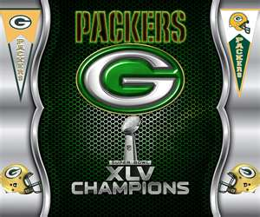
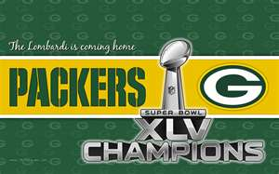
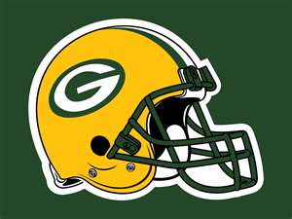
Steven.W
Symbols

Slide 2
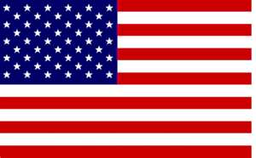
Language
I speak English.

Slide 3
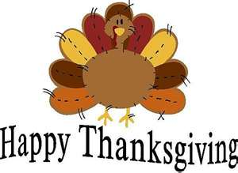
Norms, Customs, Traditions
Every Christmas me and my family, and friends go to Denys at midnight, and on Thanksgiving I play back yard foot ball.

Slide 4
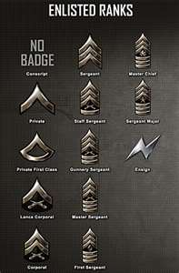
Social Collectives!
My rank in my family is probably the highest because I always have took the lift on the shoulder, and done most of the choir's in my family. I’ve always been respectful and did what I’m told, and I’m the youngest in my family. My brothers mostly have been rebellious so that’s how I rank myself.

Slide 5
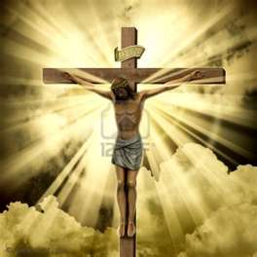
Religions and Beliefs.
I’m a Catholic.

