Slide 1
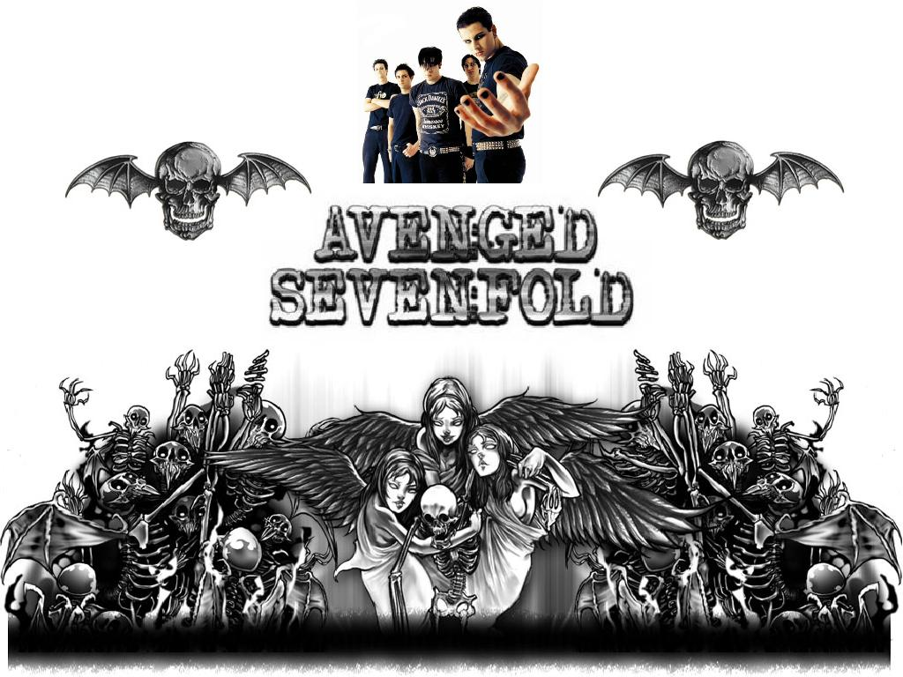
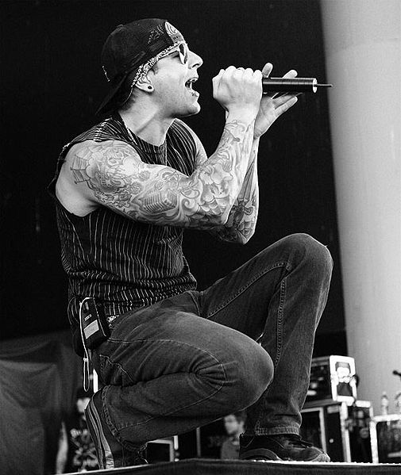
Mathew Charles sanders presentation Musical vocalists.
Steven Weaver
Steven .W

Slide 2
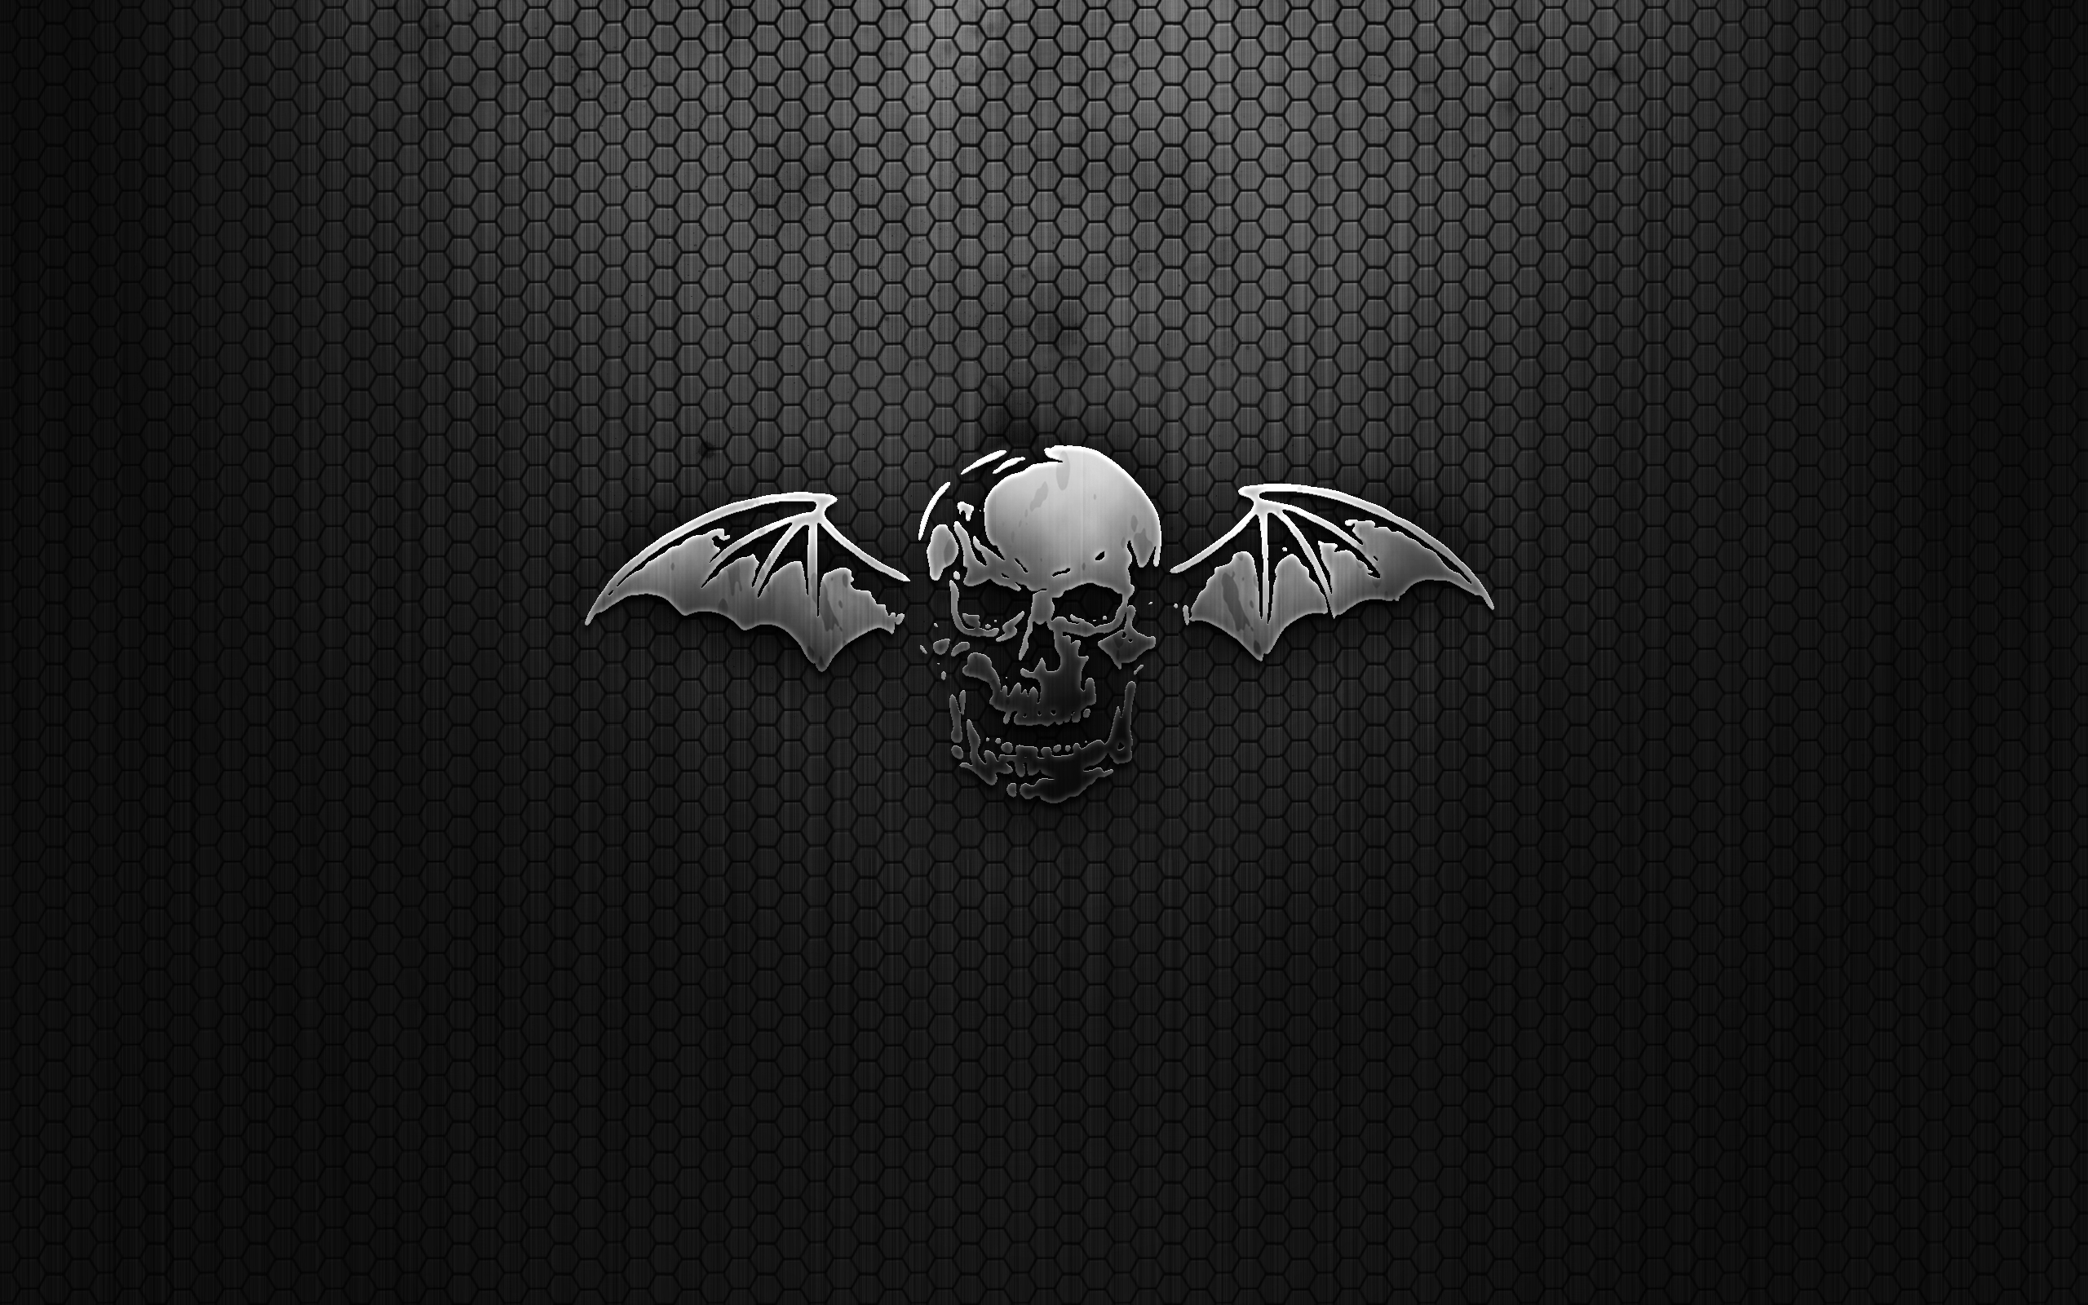
Lists of Slides
Slide 1. Mathew Charles Sanders
Slide 2. List of titles
Slide 3. Description of Mathew Charles Sanders
Slide 4. Crazy Bat Skeleton
Slide 5. Sevenfoldism
Slide 6. Mathew Charles Sanders in a awesome sketch in-between trees
Slide 7. Conclusion
Slide 8. Proposal for a next art project idea
Slide 9-13. PowerPoint resources
Slide 10. More Pictures

Slide 3
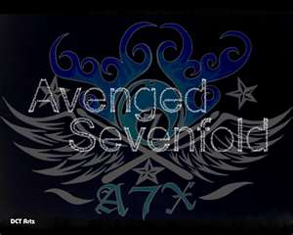
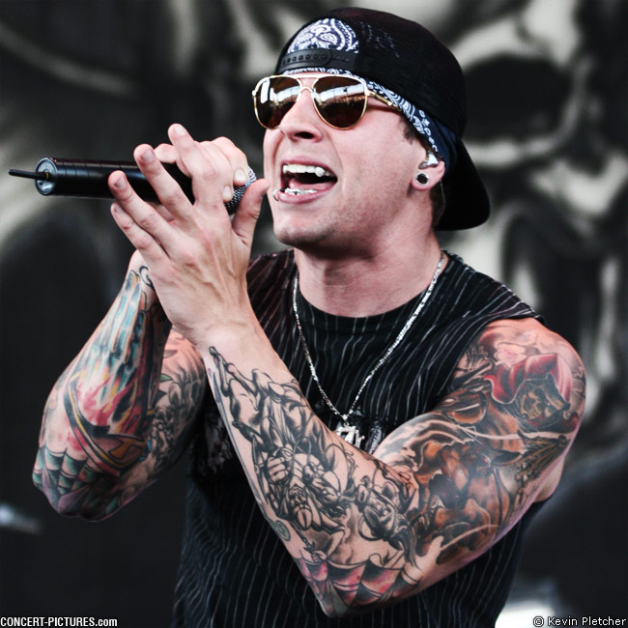
Description of Mathew Charles sanders
Mathew Charles Sanders is the vocalists for the Band Avenged Sevenfold, is an alternative rock band, and most of time wares aviator glasses, lots of tattoos, and is very muscular, and wares a baseball cap most of the time.

Slide 4
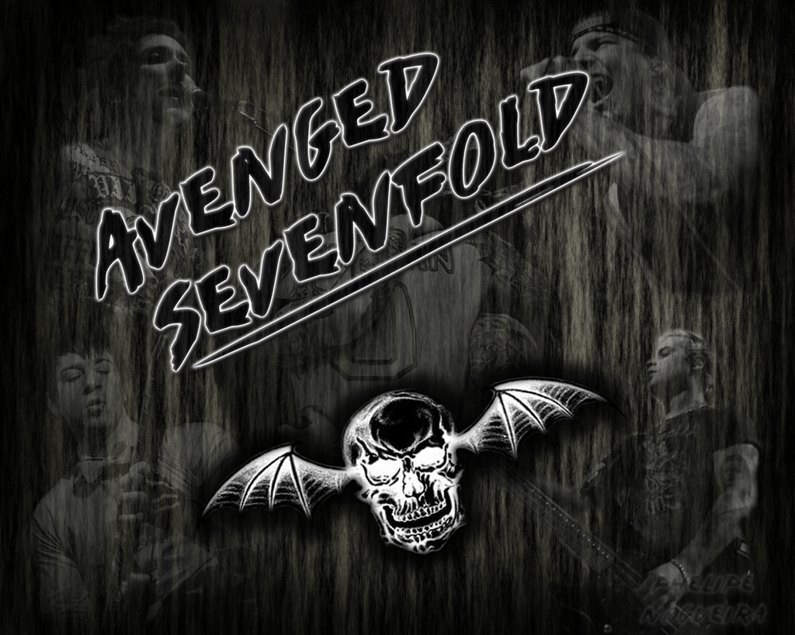
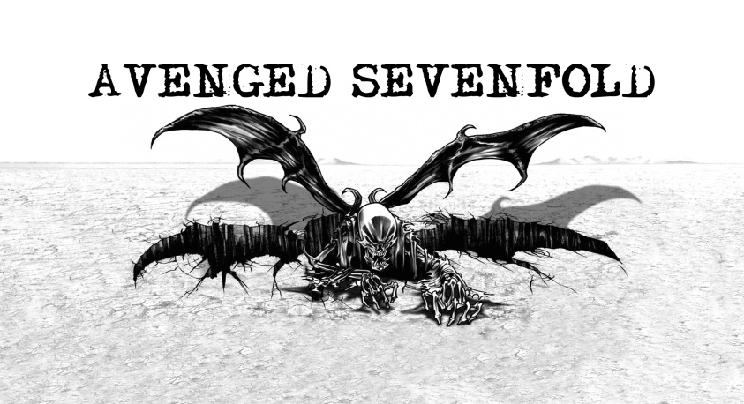
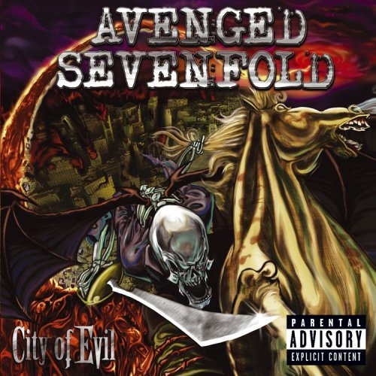
Crazy bat skeleton
I found interesting in this photo is that the skeleton in the white picture is the same skeleton in Avenged Sevenfold third album City of evil.

Slide 5
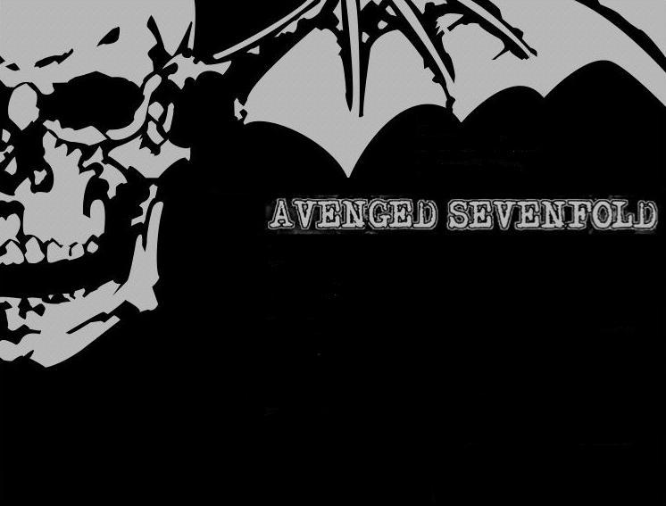
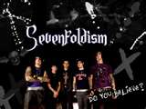
Sevenfoldism
I found really interesting is that this photo is referring to a band as a religion not a band, so I think it’s indifferent that Avenged Sevenfold would have a picture like this one.

Slide 6
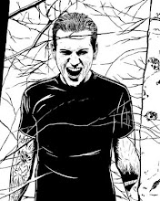
Mathew Charles sanders in a awesome sketch in-between trees
I think this picture is awesome because it’s a good sketch of art of M. Shadows in awesome pose.

Slide 7
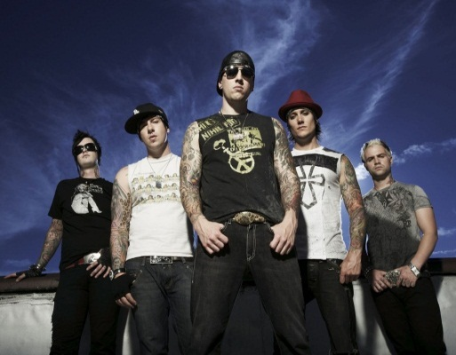
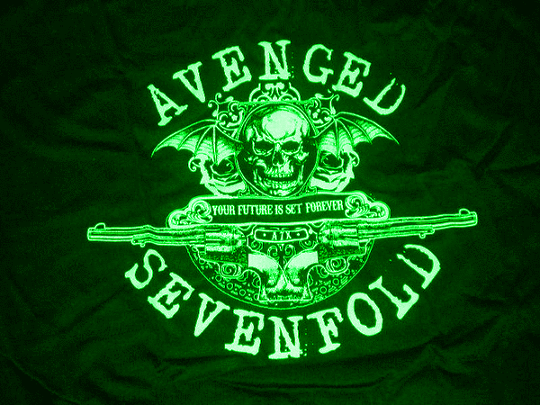
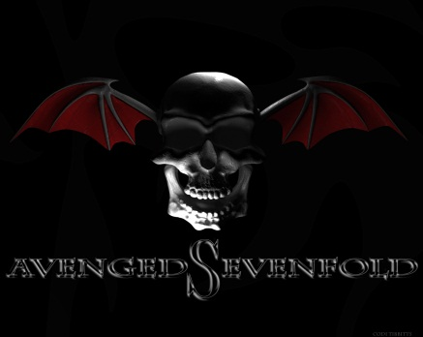
Conclusion
I chose this artist because, Mathew Charles Sanders is the vocalists in my favorite band Avenged Sevenfold, also Mathew Charles Sanders has a powerful voice and sounds different from everyone else and there will never be another Mathew Charles Sanders, known has M.Shadows.

Slide 8
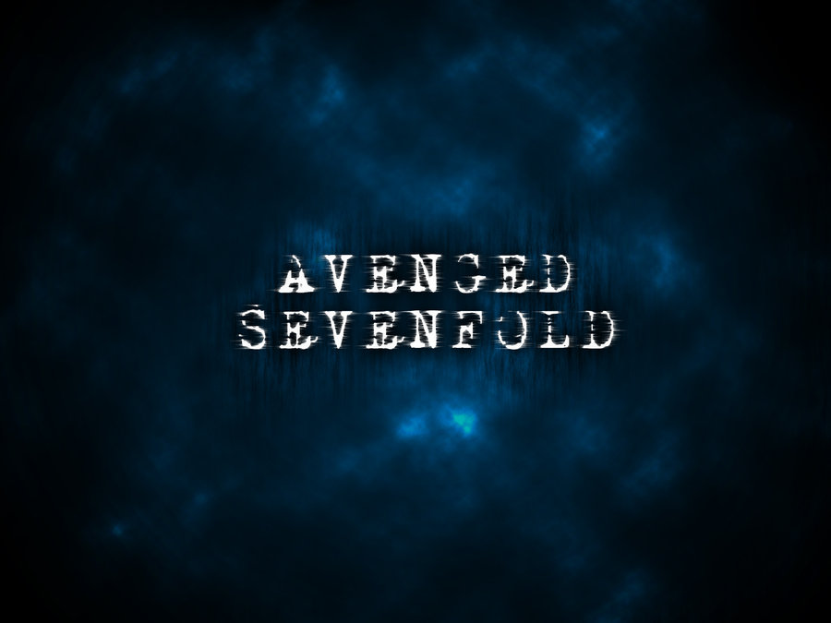
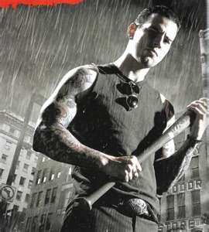
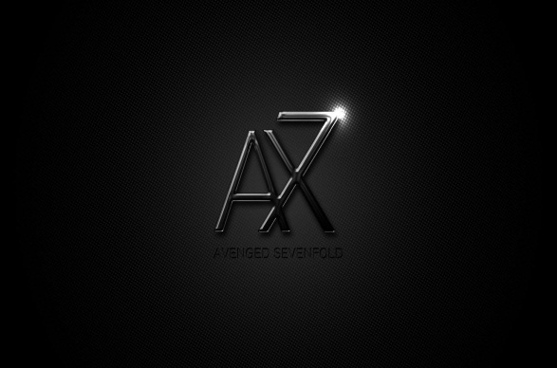
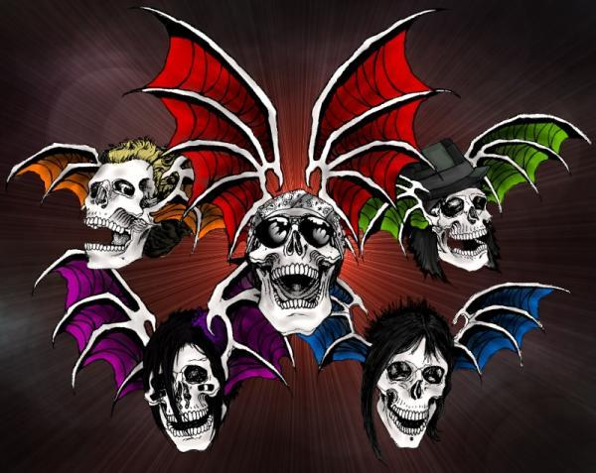
Proposal for a next art project
We should make a best musicians contest and vote has a class to clarify who’s the best musician.

Slide 9
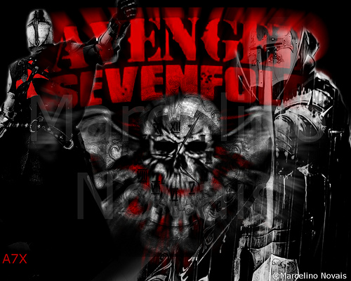
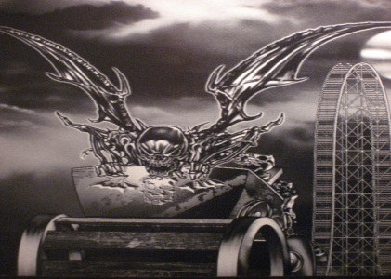
PowerPoint resources
http://www.spirit-of-metal.com/membre_groupe/photo/Matthew_Charles_Sanders_(M.Shadows)-13106_2fc7.jpg
http://3.bp.blogspot.com/_PXiQnc-n2Uo/TRHFyl6YZ-I/AAAAAAAAAOE/IqLOzB_ZH4Q/s1600/m+shadows.jpg
http://fc02.deviantart.net/fs26/f/2008/032/8/a/Avenged_Sevenfold_SkullBat_by_McKee91.jpg
http://www.rockpic.net/images/avenged-sevenfold-19.jpg
http://media.photobucket.com/image/Avenged%20sevenfold/69Lex/Avenged%20Sevenfold/avengedsevenfold91.jpg
http://images4.fanpop.com/image/photos/16200000/avenged-seven-fold-avenged-sevenfold-16258823-1024-768.jpg
http://www.downwallpapers.com/wallpapers/avenged_sevenfold-1280x960.jpg

Slide 10
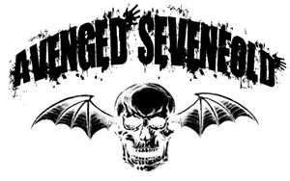
http://4.bp.blogspot.com/- rYwsY9DWjBY/TduGjaV8w5I/AAAAAAAAAAM/XBVndHQmoC0/s1600/M._Shadows.jpg
http://www.flickr.com/photos/andryy_x2/2347242609/
http://fc02.deviantart.net/fs22/f/2008/026/f/d/Avenged_Sevenfold_Wallpaper_by_Lionsden123.jpg
http://4.bp.blogspot.com/_YSt3njENT8c/S_OFNKGe42I/AAAAAAAAIzY/JqHkdJs5kf0/s400/Avenged-Sevenfold-Nightmare-Mp3-Ringtone-Download.gif
http://fc09.deviantart.net/fs11/i/2006/218/e/e/AVENGED_SEVENFOLD_by_lenore666.jpg
http://fc04.deviantart.net/fs71/f/2010/025/b/9/Avenged_Sevenfold_Wallpaper_by_JonnySnakeSeven.jpg
http://1.bp.blogspot.com/-Ab3B9gb7etk/Tb9XCtsz1xI/AAAAAAAAABU/9LUJJEMSm-U/s1600/A7X_Death_Bat_by_Codi_T.jpg
http://luvmusicnow.com/wp-content/uploads/2011/10/avenged-sevenfold.jpg

Slide 11
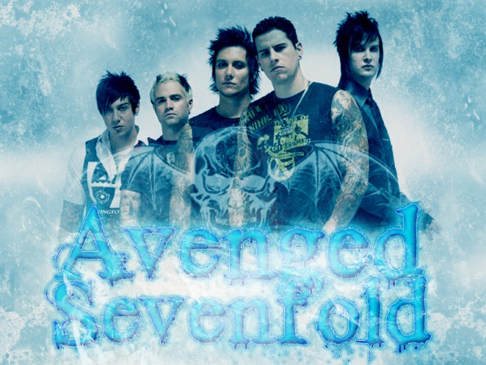
http://www.songs-lyrics.net/covers/avenged-sevenfold---nightmare.jpg
http://www.wallpapernuke.com/wallpaper/avenged-sevenfold-wallpaper-6.jpg
http://fc00.deviantart.net/fs71/i/2011/319/c/5/avenged_sevenfold_wallpaper_by_orderuchiha-d4g9qqi.png
http://www.bestrockpics.com/data/media/18/Avenged%20Sevenfold%20(13).JPG
http://www.wallpaper4me.com/images/wallpapers/avengedsevenfold-833658.jpeg
http://media.photobucket.com/image/Avevged%20Sevenfold/mohdsuhaimi/Avenged-Sevenfold-Bat-avenged-seven.jpg
http://deadhub.zippykid.netdna-cdn.com/wp-content/gallery/uploads/2011/04/Avenged-Sevenfold-Rockford-4272011-21-h.jpg
http://mariahcareycollection.com/blog/A/avengedsevenfold-notreadytodie.png
http://3.bp.blogspot.com/-LCB0xAyJfZM/Tu_tJZtbiMI/AAAAAAAAAcU/UBl228fKAcc/s1600/avenged-sevenfold-logo-wallpaper.jpg

Slide 12
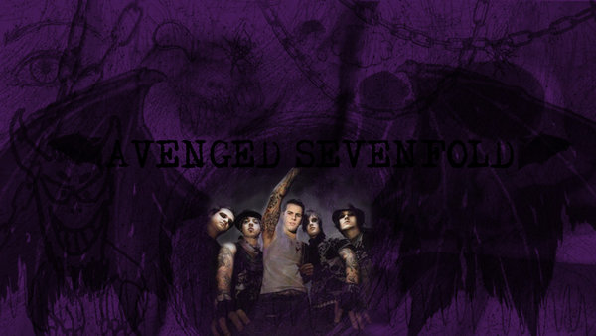
http://fc03.deviantart.net/fs71/i/2011/134/0/4/avenged_sevenfold_wallpaper_by_gustavosdesign-d3gccbm.jpg
http://th09.deviantart.net/fs24/PRE/f/2008/007/b/2/Avenged_Sevenfold_Deathbats_by_McKee91.jpg
http://fc00.deviantart.net/fs70/i/2010/081/c/6/Avenged_Sevenfold_by_Emo_Pirate_Riot.jpg
http://3.bp.blogspot.com/-RQ10PqdaPd4/TbDi6Ggg80I/AAAAAAAAAGM/lzfkLWQbVEY/s220/m-shadows-37.jpg
http://images2.layoutsparks.com/1/91566/avenged-sevenfold-a7x-green-31000.gif
http://fc08.deviantart.net/fs70/f/2011/139/f/3/avenged_sevenfold_wallpaper_by_digizo-d3gp2pt.jpg
http://cdn.buzznet.com/assets/users16/daianacosenzaa7x/default/logo-avenged-sevenfold-avenged-sevenfold--large-msg-120482176094.jpg
http://fc07.deviantart.net/fs24/f/2009/240/4/8/Avenged_Sevenfold_Wallpaper_by_angryannoyance.jpg
http://farm3.static.flickr.com/2697/4447248708_3da86ca45e.jpg
http://media.photobucket.com/image/Avenged%20Sevenfold%20Logos/captoroflove/avenged%2520sevenfold/avenged-sevenfold.gif
http://fc07.deviantart.net/fs25/i/2008/064/a/d/Avenged_Sevenfold_Wallpaper_by_SquallsNightmare.jpg

Slide 13
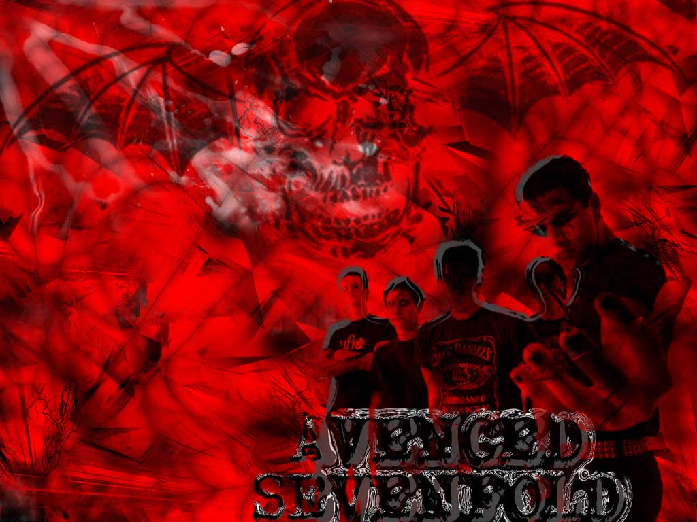
http://fc09.deviantart.net/fs29/f/2008/047/f/a/Avenged_Sevenfold_Wallpaper_by_BigBoyLloydy.jpg
http://fc09.deviantart.net/fs70/i/2011/321/0/1/avenged_sevenfold_wallpaper_by_max007x-d4gh46c.jpg
http://www.rocksound.tv/images/uploads/AvengedSevenFold20110611Download-008-Web.jpg
http://www.caffeineandscience.com/wp-content/uploads/2011/09/Uproar-002.jpg

Slide 14
