Slide 1
Future Technology

Slide 2
List of Slides
Slide 1. Future Technology
Slide 2. Lists of slides.
Slide 3. Future Technology Flexible Roll Up Screens
Slide 4. Future Technology In computers
Slide 5. Robotics
Slide 6. Smart Clothes
Slide 7. Technology in Music
Slide 8. Technology in Architecture
Slide 9. Technology In Cars
Slide 10. Resources and links to Pictures

Slide 3
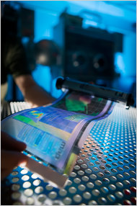
Future Technology Flexible roll up screen.
A Digital roll up computer that you can look up any book you desire and roll it on a desk, it came out in 2007 and cost 400$.

Slide 4
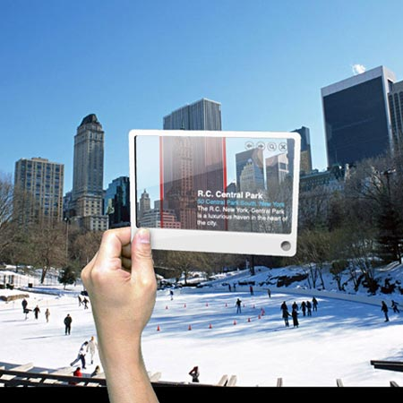
Future Technology in Computers
A computer that uses any surface or air and projects a beam screen, and wherever you are is the background.

Slide 5
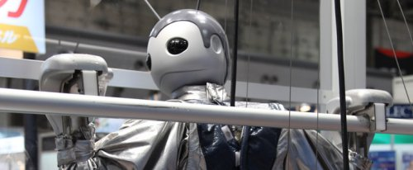
Robotics
A robot that was invented at the Shanghai Expo center also by Musclecorp. The Robot is designed to climb any vertical height that is demanded by any owner was designed to make a showcase for Musclecorp.

Slide 6
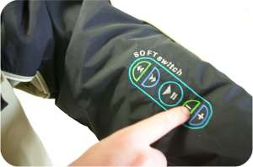
Smart Clothes
A long sleeve shirt that can hook up to any music device.

Slide 7
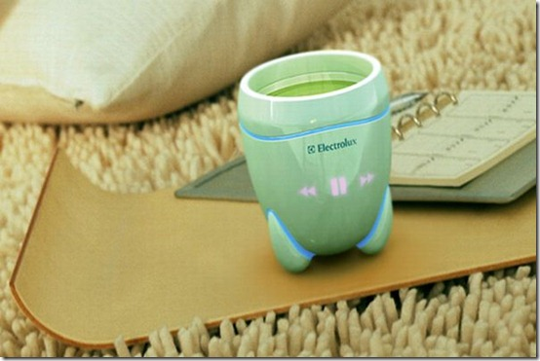
Technology in Music
A mug that can play music while you are drinking a beverage.

Slide 8
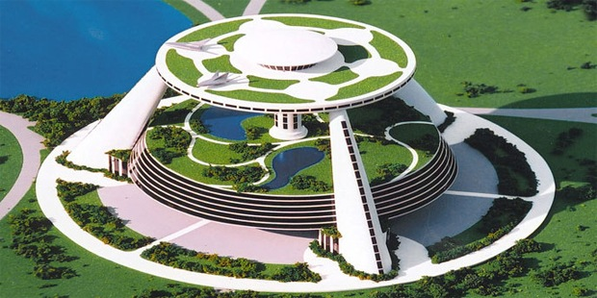
Technology in Architecture
A future High Tech Environmentally friendly city that is planned to be built in the nearby future. The cities interior uses renewable energy.

Slide 9
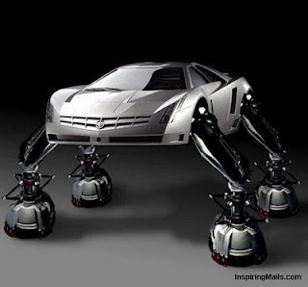
Technology in Cars
A future sports car that was an idea for many motor sport cars company. It was an idea from a Japan car company, it’s a car with legs and is operated with super electronics suspensions .

Slide 10
Resources and links to pictures
http://www.nytimes.com/2010/06/27/weekinreview/27bilton.html?_r=1
http://www.countrywidetraining.com/art/future-of-technology.htm
http://botropolis.com/?tag=robotics
http://ro-blogtechnos.blogspot.com/2008/04/smart-clothes.html
http://it-tech.org/concept-drinking-the-music/
http://all-japan-car.blogspot.com/2010_05_01_archive.htm
lhttp://glazemoo.blogspot.com/2010/06/future-city-living.html
http://www.futuretechnologypredictions.org/wp-content/uploads/Future-Technology.jpg

